Slide 1
COMP 1842
Week 1 – Vue.js intro
Matt Prichard

Slide 2
Introduction
Recap
JQuery
AJAX
JSON
SPAs
Angular and React
Vue.js

Slide 3
Recap
JS variables; var - const - let
Getting and showing data by accessing the DOM
HTTP
Request/response/headers
Status codes

Slide 4
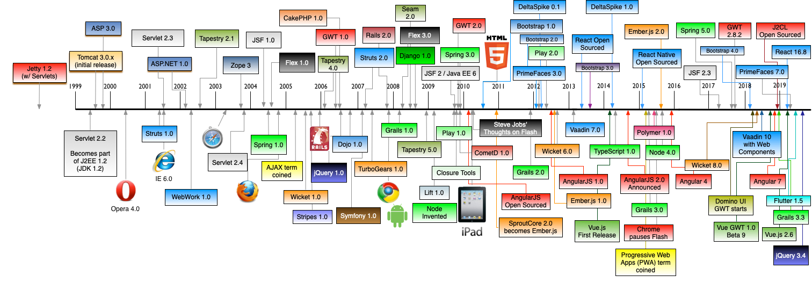
Remember this horror of a slide from week 1 ?

Slide 5




A brief overview of the current situation

Slide 6
jQuery started 2006. At the time, JavaScript was not as common and trendy as it is now. jQuery basically altered the fate of web user interfaces because it enabled developers to produce interactive experiences easily and painlessly. In other words, jQuery revolutionized the industry by shifting developers from creating primitive websites to developing web apps.

Slide 7
jQuery is a fast, small, and feature-rich JavaScript library. It makes things like HTML document traversal and manipulation, event handling, animation, and Ajax much simpler with an easy-to-use API that works across a multitude of browsers.
Go to https://jquery.com/ use the CDN to plug the library in.

Slide 8
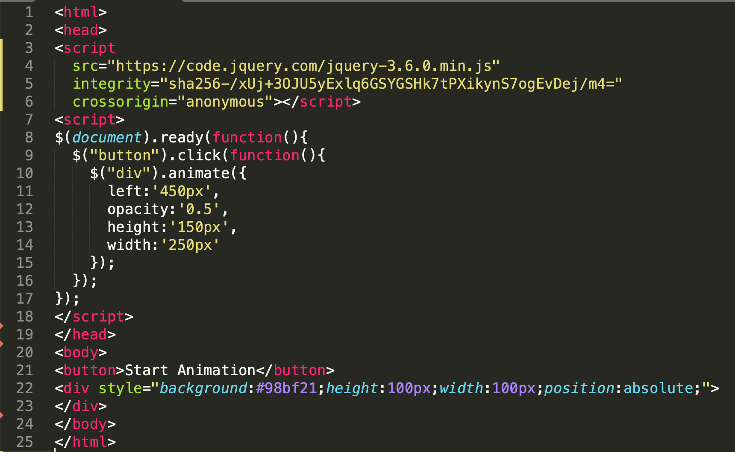
https://jquery.com/
code_examples/JQuery.html

Slide 9

One of jQuery’s biggest strengths was the simplification of AJAX

Slide 10
AJAX
Ajax (Asynchronous JavaScript and XML) is a set of web development techniques that uses various web technologies on the client-side to create asynchronous web applications. First appeared March 1999.
With Ajax, web applications can send and retrieve data from a server asynchronously (in the background) without interfering with the display and behaviour of the existing page.
Ajax allows web pages and web applications, to change content dynamically without the need to reload the entire page. In practice, modern implementations commonly utilize JSON instead of XML.

Slide 11

AJAX…cont
AJAX is not a programming language.
AJAX just uses a combination of:
A browser built-in XMLHttpRequest object (to request data from a web server).
JavaScript and HTML DOM (to display or use the data).
Remember last term all our PHP interactivity involved page reloads using Location headers or reloading the current page.
http://localhost/COMP1841/week6-03/index.php
http://localhost:8000/uni/code_examples/ajax1.html
Run server from terminal - python3 -m http.server 8000
https://www.w3schools.com/js/js_ajax_intro.asp

Slide 12
jQuery -> AJAX
The whole point of jQuery is to simplify and standardise the use of JavaScript.
jQuery provides several methods for AJAX functionality.
With the jQuery AJAX methods, you can request text, HTML, XML, or JSON from a remote server using both HTTP Get and HTTP Post and load the external data directly into the selected HTML elements of a web page.
Writing regular AJAX code can be a bit tricky, because different browsers have different syntax for AJAX implementation. However, jQuery has taken care of this for us, so that we can write AJAX functionality with only one single line of code.
http://localhost:8000/uni/code_examples/Jajax.html

Slide 13
JavaScript Fetch API
The Fetch API interface allows web browser to make HTTP requests to web servers.
No need for XMLHttpRequest anymore.
http://localhost:8000/uni/code_examples/fetch.html
To js console
https://www.w3schools.com/js/js_api_fetch.asp

Slide 14

JSON
Many software applications need to exchange data between a client and server.
For a long time, XML was the preferred data format when it came to information exchange between the two points. Then in early 2000, JSON was introduced as an alternate data format for information exchange.
https://www.w3schools.com/js/js_json_intro.asp

Slide 15
JSON - JavaScript Object Notation
JSON is a text-based data exchange format. It is a collection of key-value pairs where the key must be a string type, and the value can be of any of the following types:
Number
String
Boolean
Array
Object
null

Slide 16
Basic rules
In the JSON data format, the keys must be enclosed in double quotes.
The key and value must be separated by a colon (:) symbol.
There can be multiple key-value pairs. Two key-value pairs must be separated by a comma (,) symbol.
No comments (// or /* */) are allowed in JSON data.

Slide 17
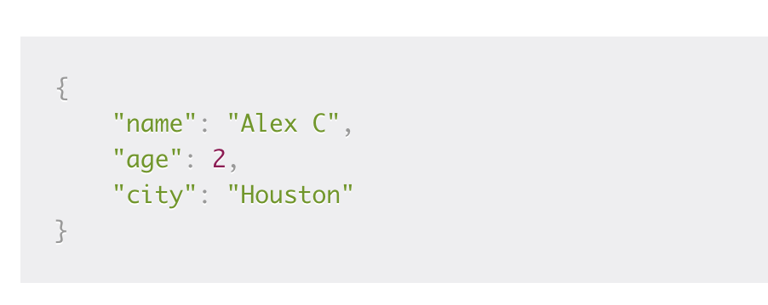
Simple JSON object
A collection of key-value pairs enclosed by a pair of curly braces {...}.

Slide 18
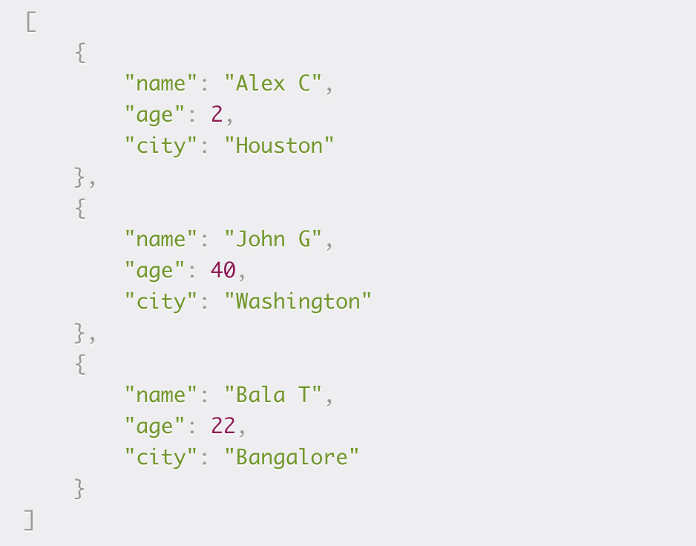
Or…JSON Arrays
A collection of an ordered list of key-value pairs separated by comma (,) and enclosed by a pair of square brackets [...].

Slide 19
JSON vs XML
A few years back, XML (Extensible Markup Language) was a popular choice for storing and sharing data over the network. JSON has emerged as a popular alternative to XML for the following reasons:
Less verbose — XML uses many more words than required, which makes it time-consuming to read and write.
Lightweight & faster — XML must be parsed by an XML parser, but JSON can be parsed using JavaScript built-in functions. Parsing large XML files is slow and requires a lot of memory.
More data types — You cannot store arrays in XML which are extensively used in JSON format.

Slide 20
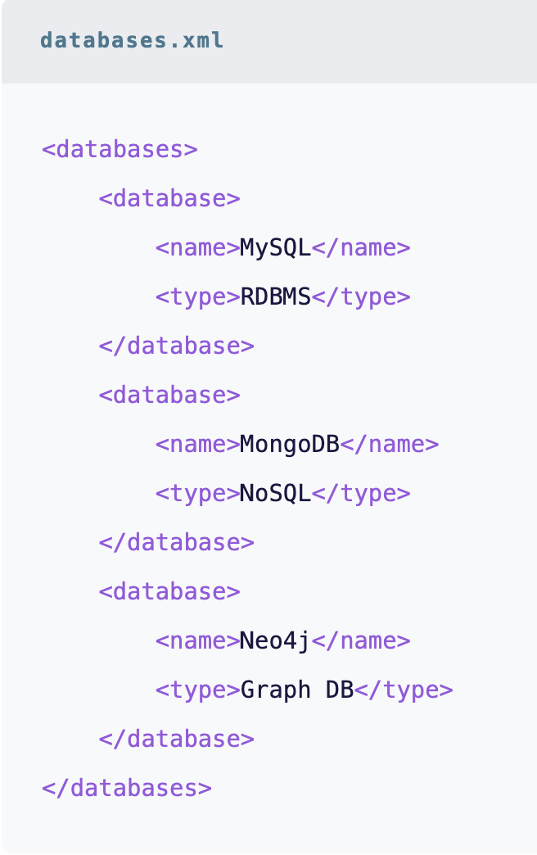
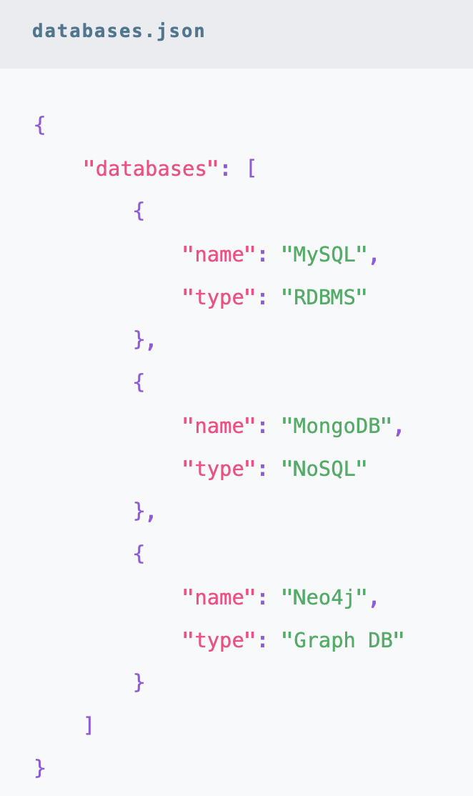
As you can see the XML structure is not intuitive. On the other hand, the JSON structure is much more compact and intuitive, making it easy to read.
Look at expanded word doc - matt.docx
Use unarchiver

Slide 21
BREAK

Slide 22
SPA
A single-page application (SPA) is a web application or website that interacts with the user by dynamically rewriting the current web page with new data from the web server, instead of the default method of a web browser loading entire new pages. The goal is faster transitions that make the website feel more like a native app.
In a SPA, a page refresh never occurs; instead, all necessary HTML, JavaScript, and CSS code is either retrieved by the browser with a single page load, or the appropriate resources are dynamically loaded and added to the page as necessary, usually in response to user actions.

Slide 23
Angular, developed by Google, was first released in 2010, making it the oldest of the big 3. It is a TypeScript-based JavaScript framework. A substantial shift occurred in 2016 on the release of Angular 2 (and the dropping of the “JS” from the original name – AngularJS).
Angular 2+ is known as just Angular. Although AngularJS (version 1) still gets updates. The latest stable version is Angular 17, which was released in November 2023.

Slide 24
Angular has a steep learning curve, considering it is a complete solution, and mastering Angular requires you to learn associated concepts like TypeScript and MVC.
Angular is the most mature of the frameworks, has good backing in terms of contributors and is a complete package.
Angular is a good choice for companies with large teams and developers who already use TypeScript.

Slide 25

React https://reactjs.org/
React, developed by Facebook, was initially released in 2013. Facebook uses React extensively in their products (Facebook, Instagram, and WhatsApp). The current stable version is 18.2, released in June 2022 (with smaller incremental updates since then).
React applications usually requires the use of additional libraries for routing, as well as certain client-side functionality.
Covered by W3schools

Slide 26

Vue…at last ☺
Vue, also known as Vue.js, is the youngest member of the group. It was developed by ex-Google employee Evan You in 2014.
Vue has seen a substantial shift in popularity, even though it doesn’t have the backing of a large company. The current stable version is 3.0, released in September 2020.
It provides higher customizability and hence is ”easier to learn” than Angular or React.

Slide 27
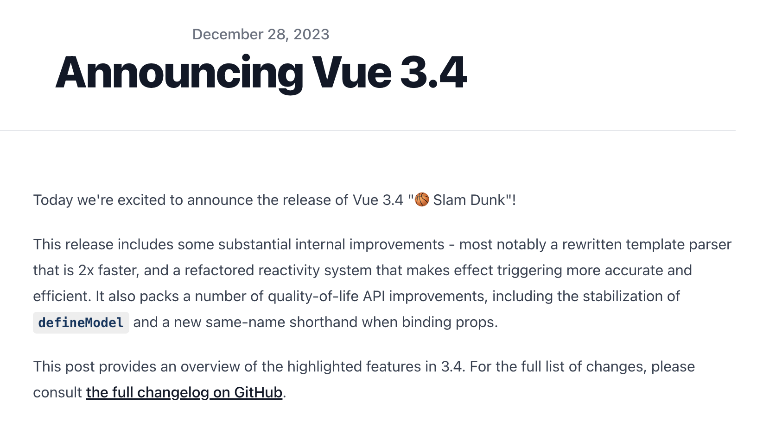

FFS ☹

Slide 28
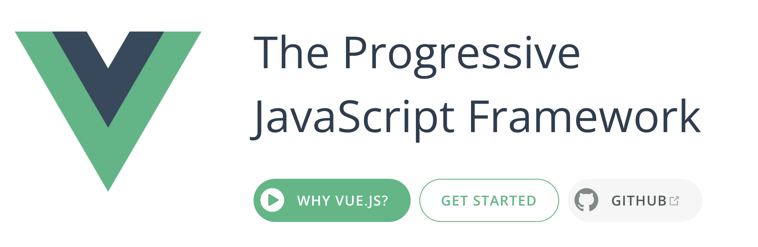
https://vuejs.org/

Slide 29
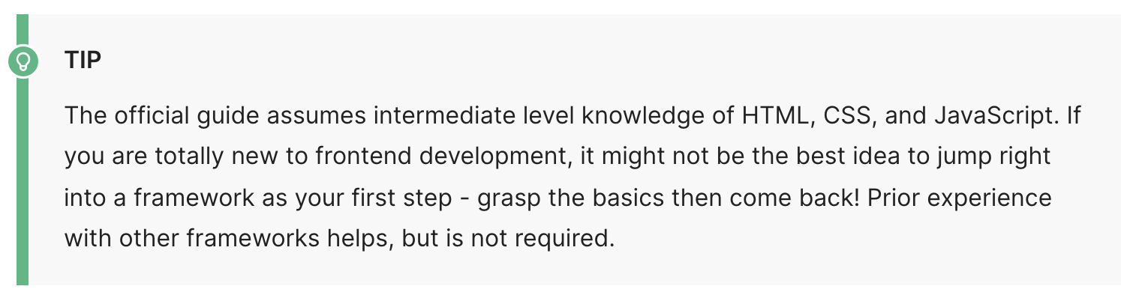
I will attempt to fill in gaps as we go, this module is broad introduction not a deep dive, don’t let the above “tip” put you off !!

Slide 30
Installation
There are four primary ways of adding Vue.js to a project:
Import it as a CDN package on the page
Download the JavaScript files and host them yourself
Install it using npm
Use the official CLI to scaffold a project, which provides batteries-included build setups for a modern frontend workflow.

Slide 31
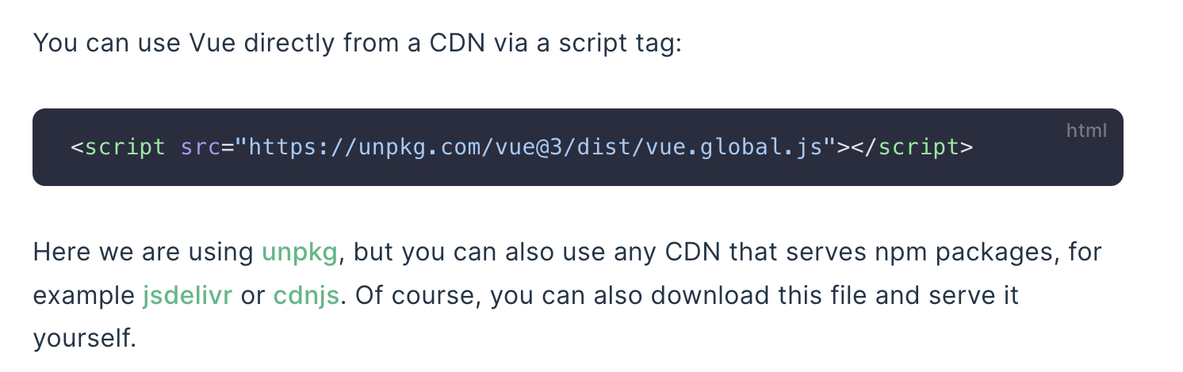
Using CDN
The following exercise can be caried out on your G Drive, we do not need to run our own server (yet).
https://vuejs.org/guide/quick-start.html

Slide 32
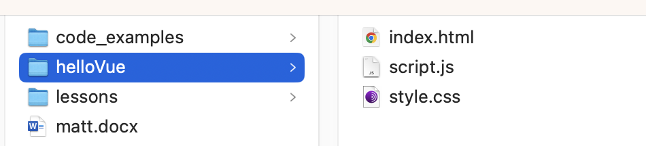
Hello Vue !!
Our basic Vue app needs an index.html, style.css and script.js
Create all these files in VS code in a folder “helloVue” on your G Drive perhaps in a COMP1842 folder

Slide 33
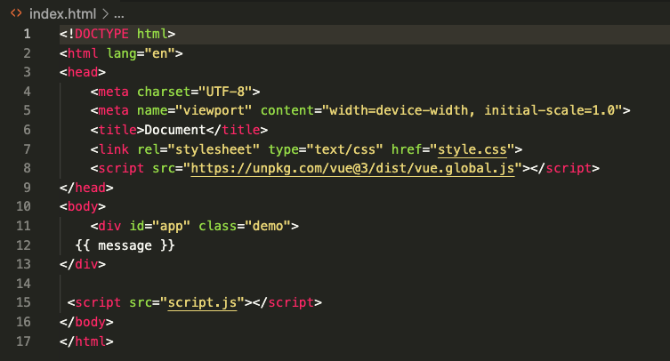
Index.html
Line 8: Connect to the Vue library using CDN
<script src="https://unpkg.com/vue@3/dist/vue.global.js"></script>
Line15: import our script file

Slide 34

Index.html…detail
Declarative Rendering
At the core of Vue.js is a system that enables us to declaratively render data to the DOM using straightforward template syntax:
See line 12 – this is also called moustache syntax

Slide 35
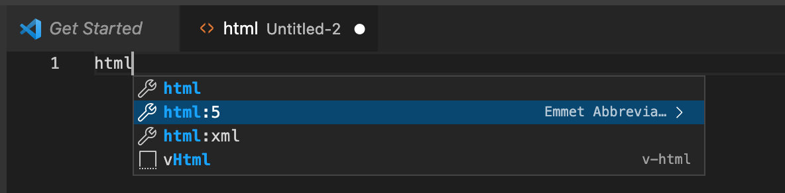
Remember
Use the html:5 boilerplate when creating a new html doc to save a lot of typing !

Slide 36
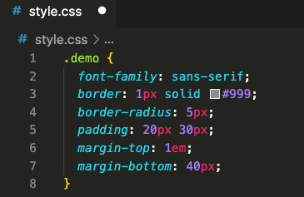
style.css
Some basic styling to the class ‘demo’

Slide 37
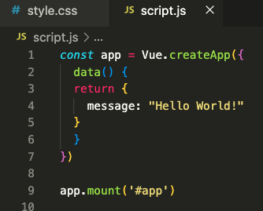
script.js
We can get a basic idea of what is happening here. Line 1 is the line that is using the Vue library’s createApp() method

Slide 38
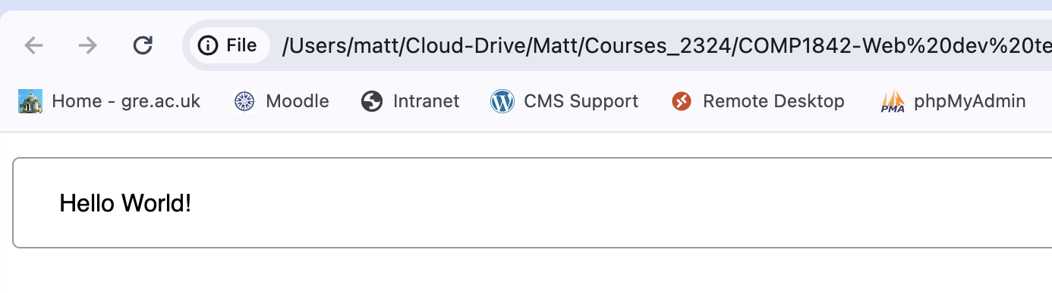
Our first Vue app
Thrilling…I know !

Slide 39
Pause for breath

Slide 40
Lesson walk through
https://www.vuemastery.com/courses/intro-to-vue-3/intro-to-vue3/
I will be using the free intro videos at the Vue site for the first few sessions. Link above, no need to re-invent the wheel,
I will walk through the first one now, you can do the rest in the labs and your own time.

Slide 41

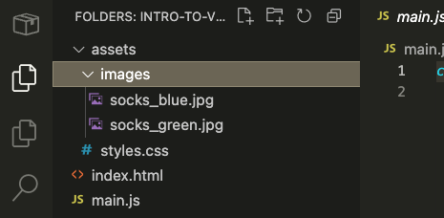
Lab task - code from Moodle
Starter code is on Moodle, when you extract it to your G Drive you will have
The 2 files we are concerned with are
index.html and main.js. Open the folder
from VSCode like we were last term to
maintain the file structure

Slide 42
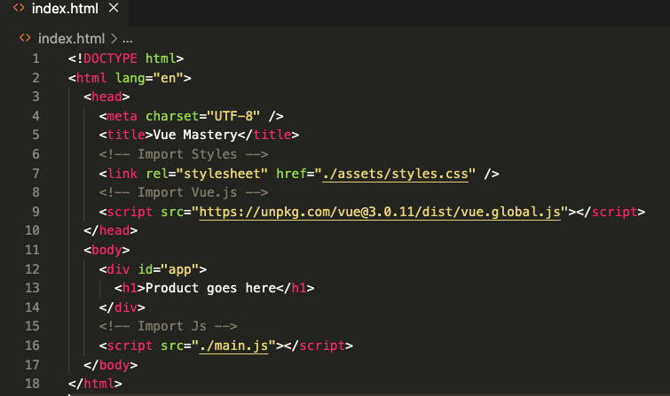
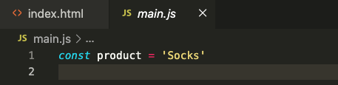

Slide 43
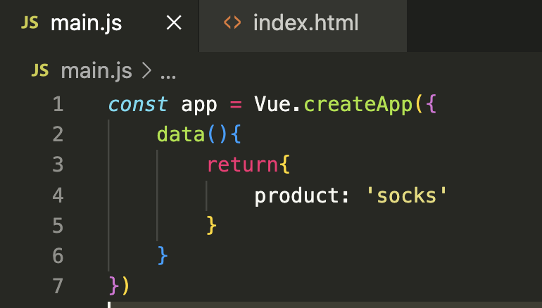
Open and edit main.js
Line 1 we create a constant called app ( remember ’const’ is one of the new JS variable types). Then we say ‘Vue’ as we have access to is through the script in the index line 9 and then we use the createApp function to create our Vue app.

Slide 44
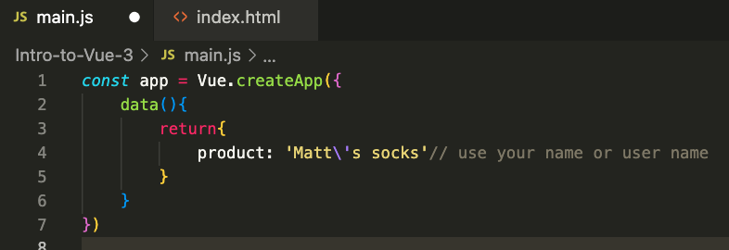
Line 2: As an argument to the createApp, we’re going to pass in an object and add a data property. This is going to be a function that returns another object, where we’ll store our data. In here, we’ll add product as a data item. Use your name or username to identify this as your work.

Slide 45
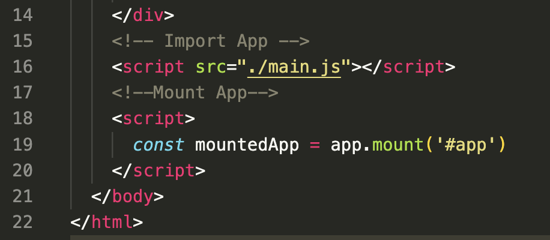
Back to index.html, change comment on line 15 to say Import App, as that is what we are doing. Create a new comment on line17 Mount App
Line 19: We’ll say app, which refers to the app that we just created, and then .mount(), which is a method that requires a DOM selector as an argument. This lets us plug the Vue app into that piece of our DOM.

Slide 46
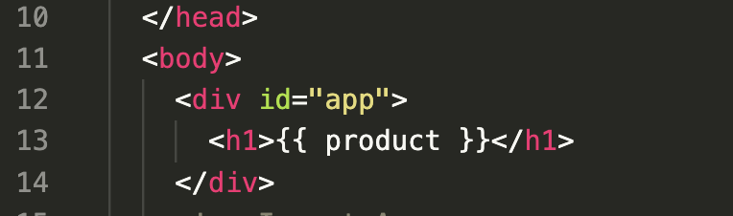
Now that we’ve created, imported and mounted out Vue app, we can now start displaying the data that lives within it.
To render the product data within the h1, we’ll write line 13
The set of double curly braces is called moustache syntax and it allows us to run valid JavaScript directly within our HTML.

Slide 47
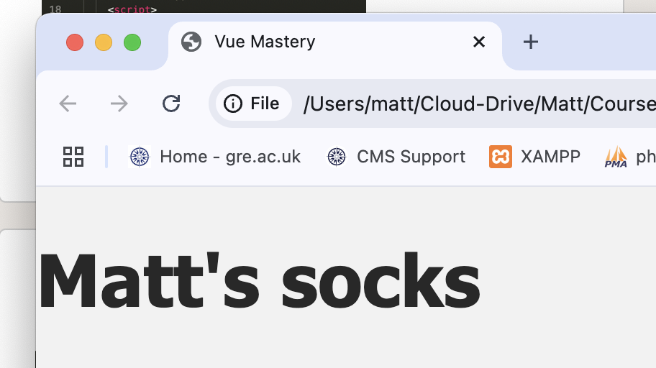
Our app in the Browser

Slide 48
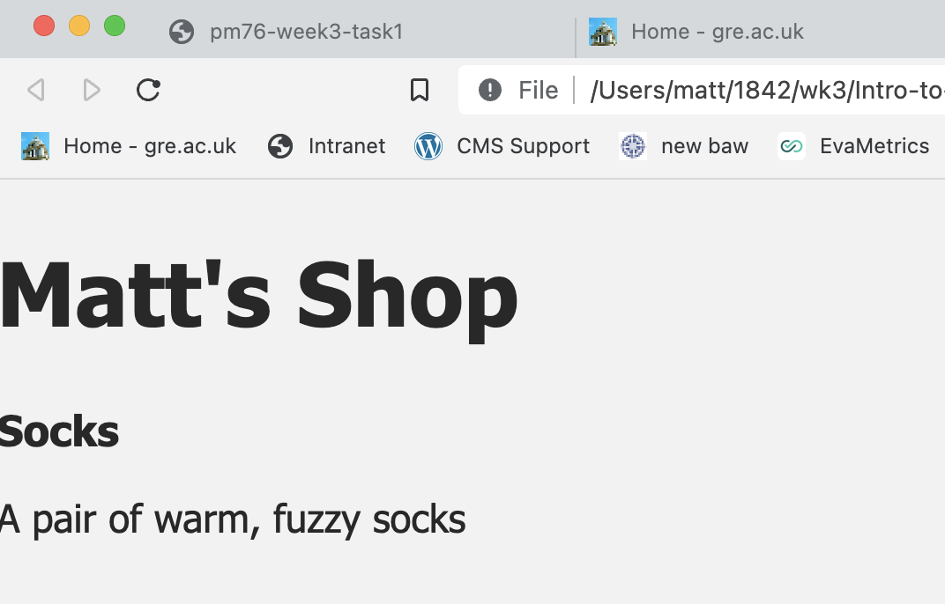
Lesson 2 challenge

Slide 49
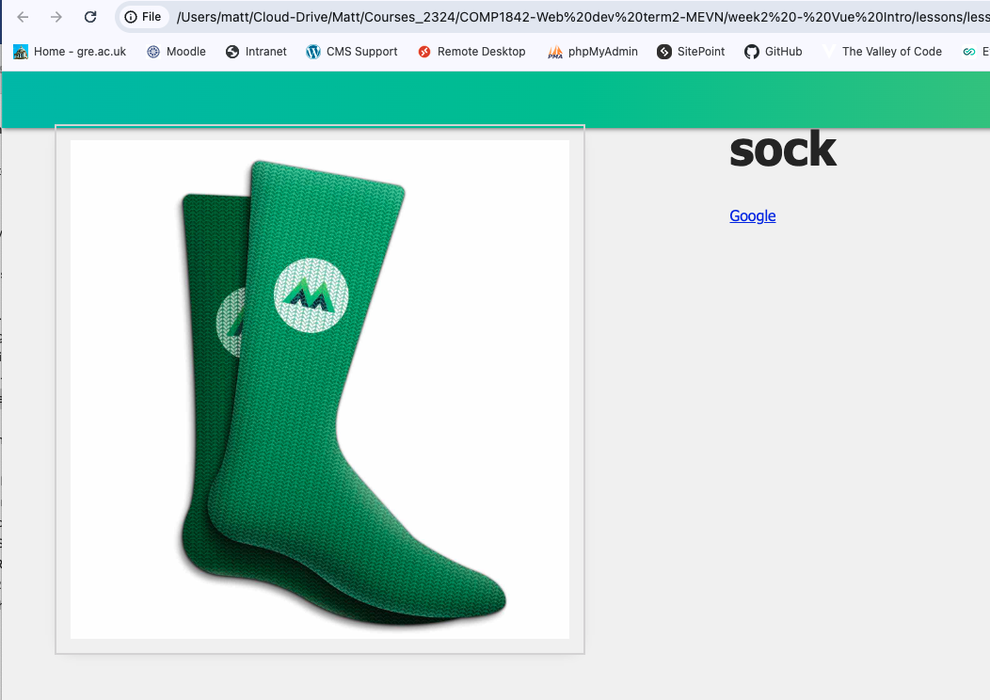
Lesson 3 completed

Slide 50
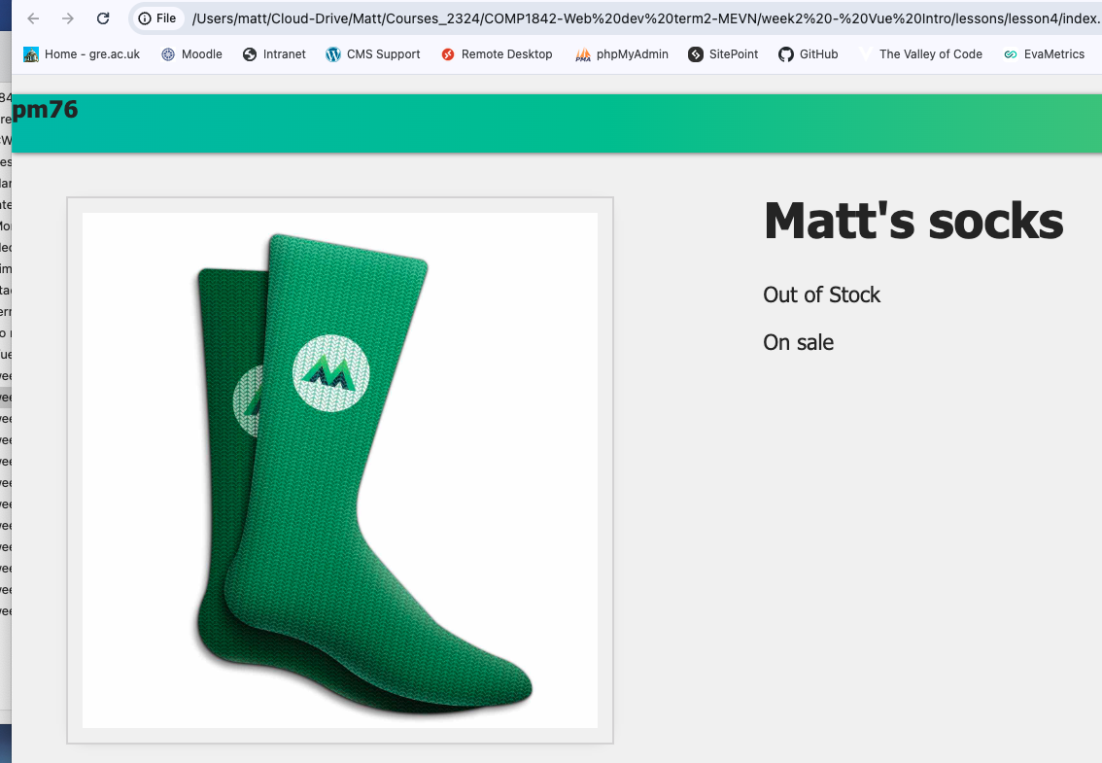
End of task 4 something like this
Make sure there is always something to identify you in the screenshots such as your name on the page and/or the header

Slide 51
Labs

Slide 52
?

